Slide 1
Nosql in Facebook
knight76.tistory.com

Slide 2
순서
기존 Facebook 시스템
Why Not Use Mysql, Cassandra Hbase가 선택된 이유 ‘정리’
#1 Messaging system 사례
#2 Real time Analytics 사례

Slide 3
Facebook Scaling & Tech (2010.6)
Scaling
570 billion pv / month
> 3 billion photos uploaded / month
1.2 million photos service /second
> 25 billion pieces of content sharded / month
> 30,000 servers (2009)
Tech
PHP (HipHop), Linux, MySQL
Haystack (photo retrieval, object store)
scribe (high-speed distributed logging)
Memcached
Bigpipe
Cassandra
Hadoop, Hive
Thrift
Varnish
http://royal.pingdom.com/2010/06/18/the-software-behind-facebook/

Slide 4
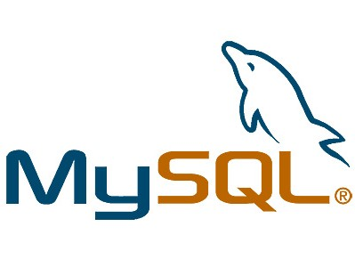
Separate Platform for Separate Task
User data
Inbox search
analytics

Slide 5
Why Not Use MySQL?
(~2011.3월까지의 자료를 근거)
As Data set & indexer grow larger, performance suffered (B+ Tree character)
Sharding can be very difficult at the scale of facebook message system (incredibly difficult problem)
Not designed to be distributed
Scaling
Master/slave : write하는 사이에 read가 들어올 때 문제, 중복 데이터 발생
Partition or sharding : application needs to be partiotion-aware, partition간의 join 엄청 불편, 분산 트랜잭션이 안되서 data integrity 문제 발생. 해결을 하면 운영비가 너무 큼
http://facility9.com/2010/11/18/facebook-messaging-hbase-comes-of-age

Slide 6
Why Not Use Cassandra?
Different consistency levels carry different risks
using a consistency level of ConsistencyLevel.ALL would require every replica to respond before the write returns to the client as successful.
Eventual consistency model is not good match for new real-time message platform
found Cassandra’s eventual consistency model to be a difficult pattern to reconcile for our new Messages infrastructure
Poor designed partition schema
Range scan issue – hot spot problem
http://ria101.wordpress.com/2010/02/22/cassandra-randompartitioner-vs-orderpreservingpartitioner/
http://facility9.com/2010/11/18/facebook-messaging-hbase-comes-of-age
http://www.facebook.com/notes/facebook-engineering/the-underlying-technology-of-messages/454991608919

Slide 7
Why Not Use Cassandra?
최근에는 Cassandra진영에서는 이런 이슈들을 대응하고 지원하는 경향이 있다. 따라서, 계속 바뀌고 있다.
(루머) Google 엔지니어들이 Facebook으로 이동해서 Google File system의 구현한 Hbase를 사용하려고 한다고 함

Slide 8
HBase를 선택한 이유
Strong consistency model
Once it's written, it doesn't matter what replica you go to. It's always in sync
새로운 시스템과 Cassandra의 Eventual consistency model를 맞추는 것이 너무 어려웠음 (메일 예제)
it's designed for automatic failover, failure dectection
When failure is the norm, we want to be able to automatically serve that data without too much intervention or it taking too much time
multiple shards per server for load balancing and preventing failure
Prevents cascading failures
when HBase breaks data into pieces and distributes them across a cluster, it puts multiple and completely separate data "shards" on each machine
http://www.theregister.co.uk/2010/12/17/facebook_messages_tech/
http://highscalability.com/blog/2011/3/22/facebooks-new-realtime-analytics-system-hbase-to-process-20.html

Slide 9
HBase를 선택한 이유 (cont)
HBase's LZO (Lempel-Ziv-Oberhumer) data compression
Save disk space and network bandwidth.
Read-modify-write operation support, like counter increment
HBase physical replication (short recovery time)
Cassandra is logical replication. With Cassandra, he says, if something gets corrupted and you lose a disk and you have to restore the data, you have to restore the entire replica. Because Facebook uses very dense machines, this would mean a very long recovery time.

Slide 10
HBase를 선택한 이유 (cont)
High availability & fast write rate
Write rate was the huge bottleneck being solved
Write ahead log enables those things
Hadoop 친구들과 함께 연동 가능
Map Reduce supported out of the box
HDFS 사용
Easy to scale, checksums data
Development and operational experience with the Hadoop echosystem

Slide 11
Hbase
Column based key-value store
Built on Big Table model
Good at fetching rows by key or scanning rages of rows and filtering
Complex query are not supported, Queries are handled by Hive(data warehouse)
Simpler consistency model than Cassandra
Very good Scalability and performance
Auto load balancing, failover, compression support, multiple shards per server
HDFS, the filesystem used by Hbase, supports replication, end-to-end checksum, automatic rebalancing
Random access performance is like Mysql
Process > 20 billion events / day (초당 20만건)
OpenTSDB 초당 20만건의 insert batch를 처리하는 데모를 테스트해봄(200k key-value) Intel E5405(2.00Ghz, 1 physical CPUS, cores/CPU, 1 hardware thread/core= 4 hw threads)
Store 135+ billion message / month in Facebook

Slide 12
Facebook’s new messaging system (2010.11.16 공식 발표)
Data
15 billion person to person message / month
135 billion chat message / month
300 million users
데이터 요구사항 중.. 다음 두 가지 데이터 특성을 측정하고 사용량을 모니터해야 한다.
A short set of temporal data that tends to be volatile
An ever-growing set of data that rarely gets accessed
결국 Mysql & cassandra 은 new messaging platform에 맞지 않다고 판단
http://www.facebook.com/notes/facebook-engineering/the-underlying-technology-of-messages/454991608919
www.quora.com

Slide 13
Project
Facebook’s largest-ever engineering project
1년소요
15 engineers으로 구성
Hbase 사용
2010.11월 – 0.89.20100924개발버전 패치 사용 중인듯. (따로 internal fork해서 쓰지 않음)
2011.3월 – HDFS 0.20-append branch 사용
0.20~0.90까지 1000이상 patch함
Thrift gateway 를 사용하지 않고, native java client를 사용
Quora.com
Fosdem.com

Slide 14
The Underlying Technology of Messages
#1
http://www.facebook.com/video/video.php?v=690851516105&oid=9445547199&comments
http://www.qconbeijing.com/download/Nicolas.pdf
http://video.fosdem.org/2011/maintracks/facebook-messages.xvid.avi

Slide 15
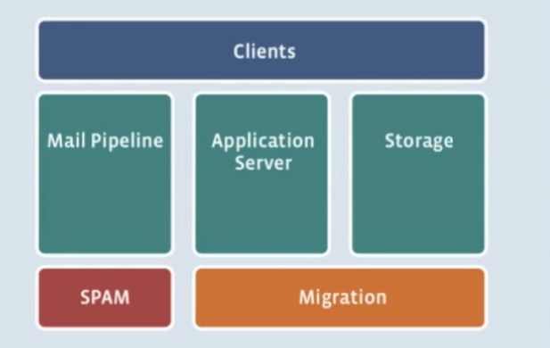
Facebook brief architecture

Slide 16
Data
Store type
Message, chats, emails, sms
Three major types of data
Message metadata and bodies : HBase
Search indices : HBase
Attachments and large message (ex. photo): Haystack
Data volume per Month
15 billion message * 1024byte = 14 TB
120 billion chat message * 100 bytes = 11TB

Slide 17
TOP Goal
Zero data loss
Stable
Performance is not top goal

Slide 18
Why to use Hbase?
storing large amounts of data
need high write throughput
need efficient random access within large data sets
need to scale gracefully with data
for structured and semi-structured data
don’t need full RDMS capabilities (cross table transactions, joins, etc.)

Slide 19
Open Source Stack
Memcached : App Server Cache
ZooKeeper : Small Data Coordination Service
Hbase : Database Storage Engine
HDFS : Distributed Filesystem
Hadoop : Asynchrous Map-Reduce Jobs

Slide 20
Architecture of Facebook
Clients
(Web server)
User Directory Service
User 에 대한 Cell 정보를 알려주세요.
Cell 1
Application
Server
Cell 1입니다.
HBase/HDFS/ZK
Haystack
http://www.quora.com/How-does-Facebook-handle-generic-search-functionality-on-HBase-for-their-new-messaging-platform?q=facebook+hbase
Notes:
-Haystack is used to store attachments.
-A custom application server was written from scratch in order to service the massive inflows of messages from many different sources.
-A user discovery service was written on top of ZooKeeper.
-Infrastructure services are accessed for: email account verification, friend relationships, privacy decisions, and delivery decisions (should a message be sent over chat or SMS?).
-Keeping with their small teams doing amazing things approach, 20 new infrastructures services are being released by 15 engineers in one year.
-Facebook is not going to standardize on a single database platform, they will use separate platforms for separate tasks.

Slide 21
Architecture of Facebook
Clients
(Web server)
User Directory Service
Cell 1
1. Message & Attachments 전달
Application
Server
HBase/HDFS/ZK
3. Message
metadata
2. Attachments 저장
Haystack

Slide 22
Architecture of Facebook
Clients
(Web server)
User Directory Service
Cell 1
Cell 2
Cell 3
Application
Server
Application
Server
Application
Server
HBase/HDFS/ZK
HBase/HDFS/ZK
HBase/HDFS/ZK
Haystack

Slide 23
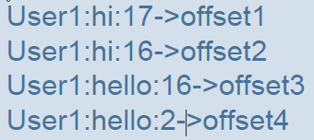
Hbase Data Model
Table (3 dimension)
RowKey, ColumnKey, Timestamp/Version
sharded into regions along an ordered RowKeyspace
Within each region
Data is grouped into column families
Sort order within each column family
Row Key (asc), Column Key (asc), Timestamp (desc)
Schema
Key: RowKey: userid, Column: word, Version: MessageID
Value: Auxillary info (like offset of word in message)
Data is stored sorted by <userid, word, messageID>

Slide 24
Data Migration
data
Over 500 million users
To migrate users
Get a list of all the messages for the user (mysql snapshot-> Hbase)
Load new message into the Hbase cluster
Perform the join operations to generate the new data
Export it and upload into the final cluster
User may still receive messages
Double-writes during the migration period

Slide 25
Hbase & HDFS
Stability & Performance
Availability and operational improvements
Rolling restarts – minimal downtime on upgrades!
Ability to interrupt long running operations(eg. Compactions)
Hbase fsck(체크), Metrics (jmx 모니터링)
Performance
Compactions (read performance를 높게)
Various improvement to response time, column seeking, bloom filters (많은 양의 데이터를 줄여서, 공간 효율으로 빠르게 검색할 수 있게 함, to minimize HFile lookups)
Stability
Fixed various timeouts and race conditions

Slide 26
Hbase & HDFS
Operational Challenges
Darklaunch (normalized된 mysql 데이터를 map/reduce를 통해 join된 데이터를 Hbase에 넣는 setup을 하는 tool)
Deployments and monitoring
Lots of internal Hbase clusters used for various purpose
A ton of scripts/dashboards/graphs for monitoring
Automatic backup/recovery
Moving a ton of data around
Migrating from older storage to new

Slide 27
&

Slide 28
Scaling Analytics Solutions Project (RT Analytics)
2011.3 발표
Took about 5 months.
Two engineers first started working on the project. Then a 50% engineer was added.
Two UI people worked on the front-end.
Looks like about 14 people worked on the product in from engineering, design, PM, and operations.

Slide 29
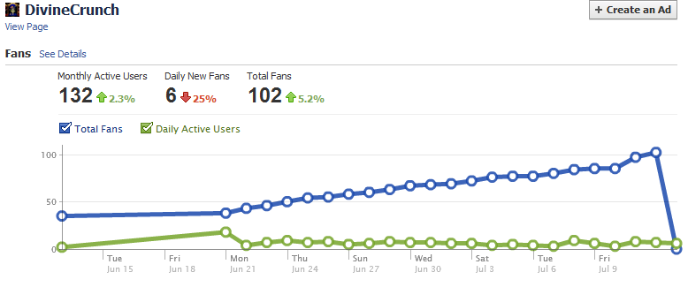
Scaling Analytics Solutions Tech Talk
#2
http://www.facebook.com/video/video.php?v=707216889765&oid=9445547199&comments

Slide 30
Scaling Analytics Solutions Tech Talk
Many different types of Event
Plugin impression
Likes
News Feed Impressions
News Feed Clicks
Massive Amounts of data
Uneven Distribution of Keys
Hot regions, hot keys, and lock contention
Impresssion : 게시물이 사용자에게 표시된 횟수

Slide 31
Considered
Mysql DB Counters
Actually used
Have a row with a key and a counter
The high write rate led to lock contention, it was easy to overload the databases, had to constantly monitor the databases, and had to rethink their sharding strategy.

Slide 32
Considered
In-Memory Counters
bottlenecks in IO then throw it all in-memory
No scale issues
Sacrifice data accuracy. Even a 1% failure rate would be unacceptable

Slide 33
Considered
MapReduce
Used the domain insights today
Used Hadoop/Hive
Not realtime. Many dependencies. Lots of points of failure. Complicated system. Not dependable enough to hit realtime goals.
HBase
HBase seemed a better solution based on availability and the write rate
Write rate was the huge bottleneck being solved

Slide 34
HBase
http://www.larsgeorge.com/2010/01/hbase-architecture-101-write-ahead-log.html
Notes:
Let"s look at the high level view of how this is done in HBase. First the client initiates an action that modifies data. This is currently a call to put(Put), delete(Delete) and incrementColumnValue() (abbreviated as "incr" here at times). Each of these modifications is wrapped into a KeyValue object instance and sent over the wire using RPC calls. The calls are (ideally batched) to the HRegionServer that serves the affected regions. Once it arrives the payload, the said KeyValue, is routed to the HRegion that is responsible for the affected row. The data is written to the WAL and then put into the MemStore of the actual Store that holds the record. And that also pretty much describes the write-path of HBase. Table is splite into roughly equal sized “region”. Each region is a contiguous range of keys, from start to end
Regions split as they grow, thus dynamically adjusting to your data set.
Hbase store state in HDFS.

Slide 35
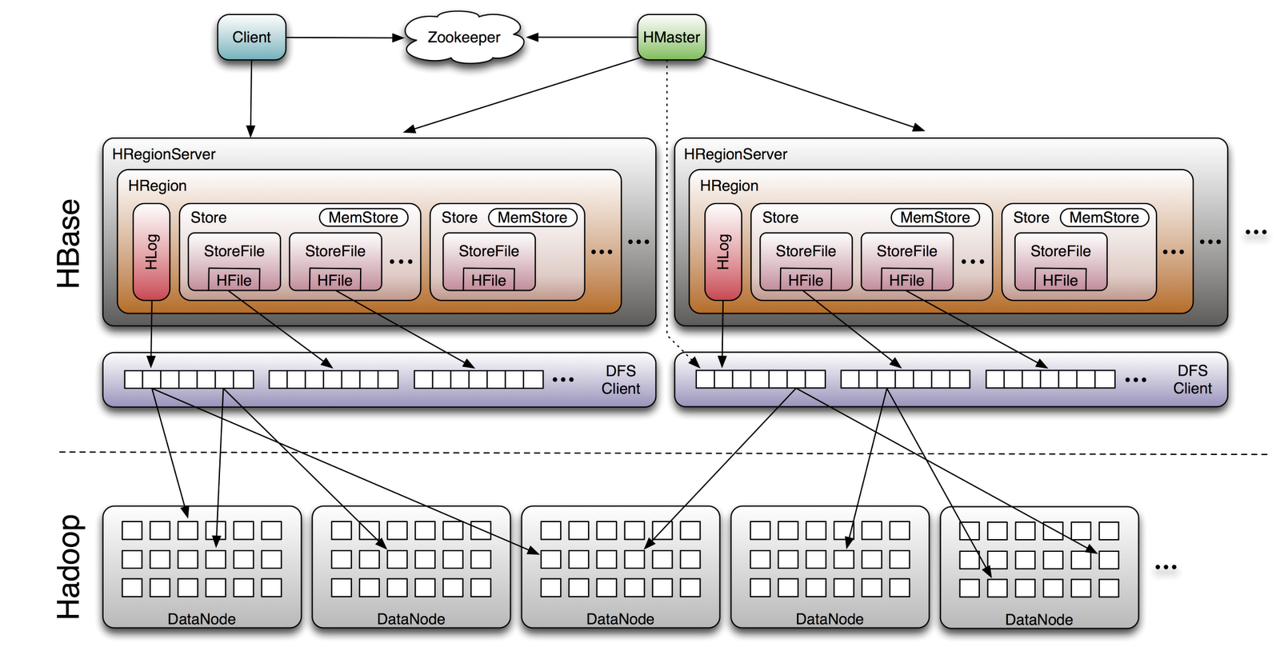
* Zookeep : metadata
* Region Server Log->Flush Store->Compaction
Region->Split
* Hmaster : recovery, loadbalance

Slide 36
Why chose HBase
Key feature to scalability and reliability is the WAL, write ahead log, which is a log of the operations that are supposed to occur.
Based on the key, data is sharded to a region server.
Written to WAL first.
Data is put into memory. At some point in time or if enough data has been accumulated the data is flushed to disk.
If the machine goes down you can recreate the data from the WAL. So there's no permanent data loss.
Use a combination of the log and in-memory storage they can handle an extremely high rate of IO reliably.

Slide 37
Schema
Key
Domain row key = md5 hash of reversed domain + reversed domain (com.facebook/something)
URL row key = md5 hash of reversed domain + reversed domain + url ID
Value : counters
Optimized Key for
Scanning urls in a given domain
Partition range of prefixes across region servers
Fast access

Slide 38
column schema design
Counter column families
Different TTL(Time to live) per family
Flexible to add new keys
Per server they can handle 10,000 writes per second
Store on a per URL basis a bunch of counters.
A row key, which is the only lookup key, is the MD5 hash of the reverse domain for sharding

Slide 39
특이한 점
Currently HBase resharding is done manually.
Automatic hot spot detection and resharding is on the roadmap for HBase, but it's not there yet.
Every Tuesday someone looks at the keys and decides what changes to make in the sharding plan.

Slide 40
END

